Slide 1
R programming Final Project
By - Arpan Manna

Slide 2
Objective
By the given data from Auto Insurance Company, the Customer Lifetime Value (CLV) needs to be predicted.
The main objective of this project is to create a Linear Regression Business model from the given data in R program.
Predict the CLV, Find significant variables, Interpretation and giving useful recommendation on business.

Slide 3
Details of the Business Model
To predict the Customer Life Value, a Linear Regression Model was created in R. After successful creation here are the results and the interpretations :
1.R-squared = 0.925 & Adjusted R-squared = 0.9247. Higher the value of R-square the better the model is.
2.MAPE value = 0.1022. Lower the MAPE value means low percentage of error in the model which we got 10.22%.

Slide 4
Significant Variables
There are total 23 variables from which the variables which are most significant related to the predicted data are as follows:
Coverage
Education
Effective to date (01/03/11, 01/08/11)
Employment status
Gender (M)
Income
Marital status
Monthly premium auto
Number of open Complaints
Number of policies
Vehicle class (Luxury SUV, SUV)

Slide 5
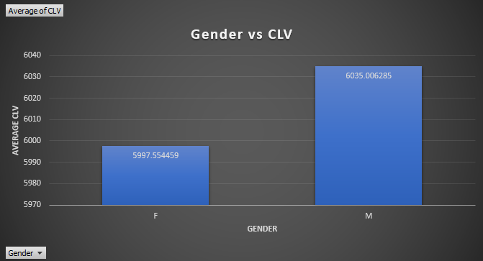
Gender
The CLV is found to be higher in case of male customers than Female customers.

Slide 6
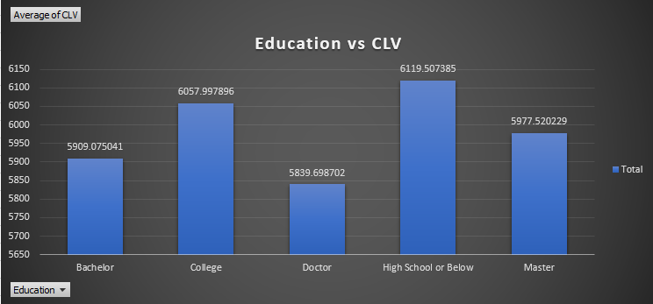
Education
We can see the customers having High School or Below degree are having highest average CLV and with the Doctor degree there are lowest average CLV.

Slide 7
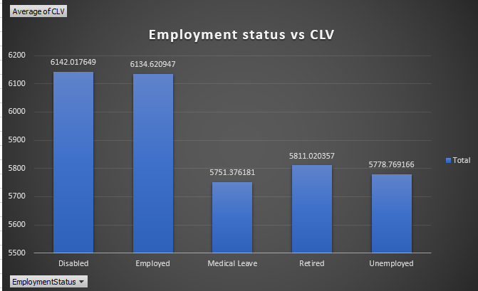
Employment status
As we can see Average CLV is high with the customers having Employment status as Disabled and Employed than the rest.

Slide 8
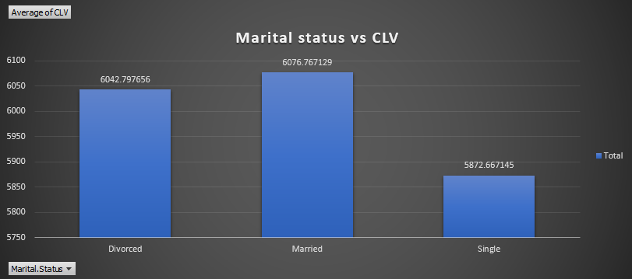
Marital Status
CLV of the customers who are single are having significantly low. Where as Married persons are having a bit more CLV than the Divorced.

Slide 9
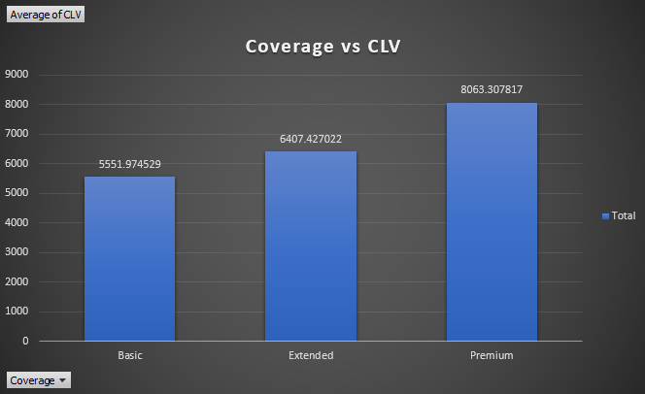
Coverage
Customers with the Premium coverage are having significantly higher CLV than the rest

Slide 10
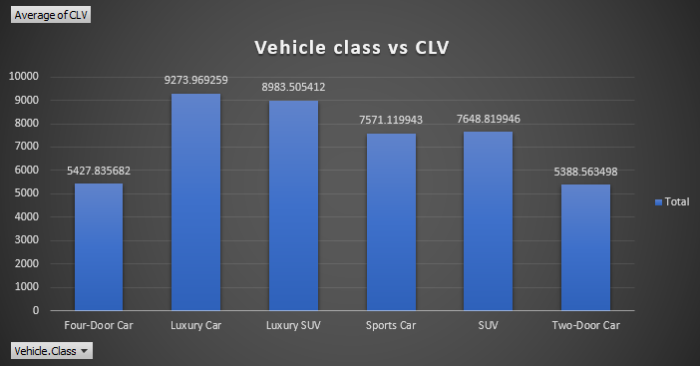
Vehicle Class
Customers who are having Luxury car got higher CLV, followed by Customers having Luxury SUV, SUV, Sports car.

Slide 11
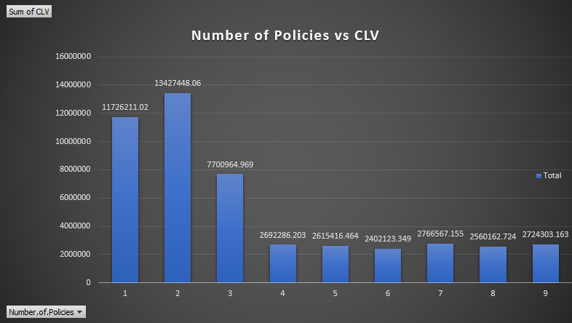
Number of Policies
Customers having 2 Policies are found to have much higher CLV. Where as Customers having more than 4 policies have significantly lower CLV.

Slide 12
Business Recommendation
Male customers who are having College degree and Luxury car should be the highest priority.
Female Doctors having normal 2 door or 4 door cars should be the lowest priority.
Special offers should be given to customers insuring Luxury cars and Luxury SUVs.
Certain offers should be given to the Customers who are taking premium coverage.
Customers with higher income should be prioritize.

Slide 13
Thank You

